Slide 1

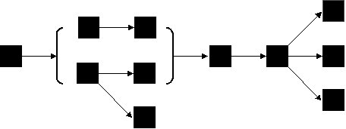
A
B
Find root nodes (starting points), compare and order with
node comparator. Process in order.
Traverse graph using edge comparator.
C
D
Capping unit
underdetermined
Alternative subgraph
Linkages between nodes are compared and traversed
in order of the linkage comparator (multigraph problem).
The sequence of specialized subgraphs / concurrent
information is handled by specialized comparators.

